Slide 1
WELCOME TO
OUR CLASS
CROSSWORD PUZZLE

Slide 2
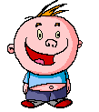
CROSSWORD
PUZZLE

Slide 3
Keyword: Tet Holiday
1
M
I
D
A
U
T
U
M
N
2
H
U
N
G
T
E
M
P
L
E
3
E
A
S
T
E
R
4
H
A
L
L
O
W
E
E
N
5
R
I
C
E
C
O
O
K
I
N
G
6
V
A
L
E
N
T
I
N
E
7
C
H
R
I
S
T
M
A
S
8
W
E
D
D
I
N
G
9
T
H
A
N
K
S
G
I
V
I
N
G
10
B
I
R
T
H
D
A
Y
1
2
3
4
5
6
7
8
9
10

Slide 4
What is the name of the festival?”

Slide 5
What is the name of the festival?”

Slide 6
What is the name of the festival?”

Slide 7
What is the name of the festival?”

Slide 8
What is the name of the festival?”

Slide 9
What is the name of the festival?”

Slide 10
WHAT IS THE NAME OF THE FESTIVAL?

Slide 11
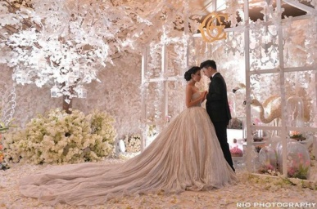
WHAT IS THE NAME OF THE FESTIVAL ?

Slide 12
What is the name of the festival?”

Slide 13
What is the name of the day?

Slide 14
Unit 13 : FESTIVALS
LESSON 3 : LISTEN

Slide 15
VOCABULARY

Slide 16
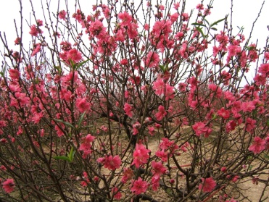
peach blossom (n):

Slide 17
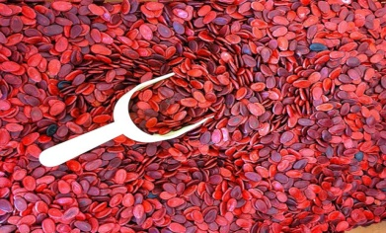
dried watermelon seed (n):

Slide 18
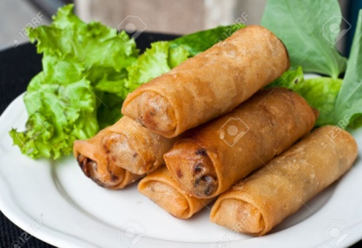
spring roll(n):

Slide 19
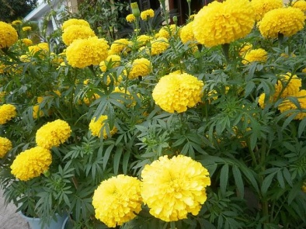
marigold (n):

Slide 20
bunch (n):

Slide 21
Mr. Robinson
Mrs. Robinson
Liz

Slide 22
1. Listen to the conversation and fill in the gaps.
-The Robinson are making preparations for Tet.
a) Mrs. Robinson wants ________________ to go to the_______________.
b) Mrs. Robinson wants some marigolds because they are ______________ at Tet.
c) Mrs. Robinson wants Liz to buy a packet of ____________________.
d) Mrs. Robinson is asking Mrs. Nga how to _________ spring rolls.
Mr. Ronbinson
flower market
traditional
dried watermelon seeds
make

Slide 23
Complete the notes.
Things to do
Mr. Robinson:
Liz:
Mrs. Robinson:
Go to the flower market to buy peach blossom and a bunch of flower (marigolds)
Go to the market to buy candies
and a packet of watermelon seeds
Go to Mrs. Nga’s house to learn how to make spring rolls

Slide 24
3. Answer the questions.
What does Mr. Robinson have to do?
Why does Liz have to go the market?
Does Mrs. Robinson know how to make spring rolls?
What is Mrs. Robinson going to do?

Slide 25
1. What does Mr. Robinson have to do?
→ He has to buy some peach blossoms and a bunch of flowers
2.Why does Liz have to go the market?
→Because Liz’s mother needs to buy candies and a packet of watermelon seeds.
3.Does Mrs. Robinson know how to make spring rolls?
→ No, she doesn’t
4.What is Mrs. Robinson going to do?
→ She is going to Mrs. Nga’s house to learn how to make spring rolls.

Slide 26
Tell about your family’s preparations for the TET.
Cook/ make cakes
Buy new clothes
Buy to food and drink
What do you often prepare for Tet?
Buy candy or cake
Clean the house
Decorate the house

Slide 27
Homework
Learn by heart the vocabulary
Prepare the next lesson Unit 13: Festival. Lesson 4: Read

